Slide 1

VISHWAKARMA INSTITUTE OF INFORMATION TECHNOLOGY
DEPARTMENT OF INFORMATION TECHNOLOGY
Course - ARTIFICIAL INTELLIGENCE (IT31231)
Topic – Risk2Image : AI-Based Breast Cancer Risk Forecasting with Visual Depiction
TY-IT-A 2025-26
Sr No. | Name | Roll No | PRN | Email ID
1 | PRATHMESH BOGE | 331077 | 22420163 | prathmesh.22420163@viit.ac.in
2 | ARPITA PATIL | 331079 | 22420198 | arpita.22420198@ viit.ac.in
3 | ARYAN BHOPALE | 331081 | 22420224 | aryan.22420224@viit.ac.in
4 | PRASHANT SONTAKKE | 331082 | 22420248 | prashant.22420248@ viit.ac.in
Course Teacher - Prof. Riddhi Mirajkar
01

Slide 2
Contents
Introduction : Problem And Our Solution ………………………………………… Page 3
Literature Review : Identifying Gaps in Current Research………………………… Page 4 and 5
Proposed System: Solution And System Architecture………………………………Page 7
Result Analysis: Breast Cancer Module Performance and Project Outcomes ………..Page 10
Advantages And Disadvantages: Realistic Assessment……………………………….Page 11
Conclusion……………………………………………………………………………Page 12
References……………………………………………………………………………Page 13 and 14
Live Demo | Q&A
02

Slide 3
Introduction
The Problem
  Most existing breast cancer prediction tools present results only as numerical scores, probabilities, or general labels like “low risk” or “high risk.”
  Such outputs are mathematically accurate but often confusing or meaningless to patients, especially for those with low health literacy or who rely more on visual communication.
  These systems do not provide any patient-specific images that could make the risk easier to interpret or personalize the outcome.
  They also lack automated report generation, which limits their usefulness in clinical consultations and reduces the overall impact on preventive healthcare.
  As a result, patients often fail to take timely action, and healthcare providers face challenges in effectively communicating risk levels.
Our Solution – Risk2Image
Prediction of breast cancer risk using patient-specific clinical and lifestyle data, producing accurate probability values (e.g., 0.98).
Conversion of these probability scores into clear, descriptive interpretations that are easy for non-experts to understand.
Generation of personalized, mammogram-style or symbolic medical images through advanced generative AI models to visually represent risk levels.
Compilation of results into structured reports that integrate numerical risk scores, explanatory text, and AI-generated visuals.
03

Slide 4
Literature Review
S.No | Title | Methodology Used | What It Does | Limitations
1 | Predicting Breast Cancer using Machine Learning | SVM, Random Forest, KNN | Predicts breast cancer from structured data | No image output or visualization; purely predictive
2 | Deep Learning for Breast Cancer Diagnosis | CNN on histopathology images | Diagnoses cancer from biopsy images | Needs medical images as input; no risk prediction
3 | Explainable AI for Medical Imaging | Grad-CAM with CNNs | Generates heatmaps to explain predictions | Only applicable for image input, not risk visualization
4 | Multimodal Breast Cancer Prediction | Combines text and image features | Improves accuracy by fusing data sources | Does not visualize outcomes for patient understanding
5 | Breast Cancer Risk Estimation with ML | XGBoost + Genetic data | Predicts 5-year risk of cancer | Textual result only; lacks engagement and interpretability
6 | Generative Adversarial Networks in Healthcare | GANs for medical image synthesis | Generates synthetic medical images for training | Not tied to patient-specific risk; no predictive link
04

Slide 5
Sr.No | Title | Methodology Used | What It Does | Limitations
7 | Data-Driven Risk Visualization for Cancer | ML + Infographics Design | Converts structured predictions to infographics | No generative AI; lacks interactivity
8 | AI-Driven Breast Cancer Risk Classification | Ensemble Learning, SHAP | Interpretable risk prediction with feature insight | No visual representation for end-users
10 | Personalized Breast Cancer Risk Communication Tool | NLP + ML | Generates reports based on personal risk factors | Focused on text explanation; lacks visual representation
11 | Predictive Modeling for Breast Cancer in Mobile Apps | Logistic Regression, Decision Trees | Integrates ML into mobile platforms for screening | No image component; mobile-specific usability concerns
12 | Deep Generative Models for Medical Visualization | VAE, GAN | Synthesizes medical visuals for education/training | Not integrated with individual patient data or risk scores
13 | Hybrid AI Models for Breast Cancer Prediction | CNN + Structured Data Fusion | Combines image and tabular data for better accuracy | Does not offer visual risk explanation for general users
14 | AI-Based Health Communication via Visual Storytelling | Visual Narratives + ML Output | Uses narrative visuals to explain health risks | Limited dataset applicability; less scientific in tone
15 | Human-AI Interaction in Health Diagnostics | User-Centered Design + ML | Explores usability of AI in diagnostics | No generative component; mostly UX evaluation
05

Slide 6
Gap Analysis
Existing models give accurate predictions but restrict outputs to numerical values, limiting patient understanding.
Imaging-based methods are powerful yet lack integration with structured lifestyle and clinical data.
Explainability tools like Grad-CAM/SHAP aid transparency but remain too technical for patients
Generative models create visuals, but these are generic and not personalized to patient data.
Infographic or narrative approaches improve clarity but stay static or text-only, missing visual engagement.
Mobile screening apps enhance accessibility but still rely on plain text and numbers without images.
Most prior work focuses on accuracy, overlooking patient-centered communication, personalized visuals, and report generation.
06

Slide 7
Proposed System – Solution
1) Patient Data Entry:
Collection of clinical, lifestyle, and genetic information.
2) Data Preprocessing:
Validation, cleaning, and normalization of patient data.
3) Risk Prediction:
ML model (XGBoost) calculates breast cancer risk score.
4) Visualization & Report Generation:
Risk score converted into descriptive text + AI-generated medical-style images + structured report (PDF/HTML).
5) User Interface / Dashboard:
Web-based platform to deliver reports and visuals to patients & clinicians.
07

Slide 8
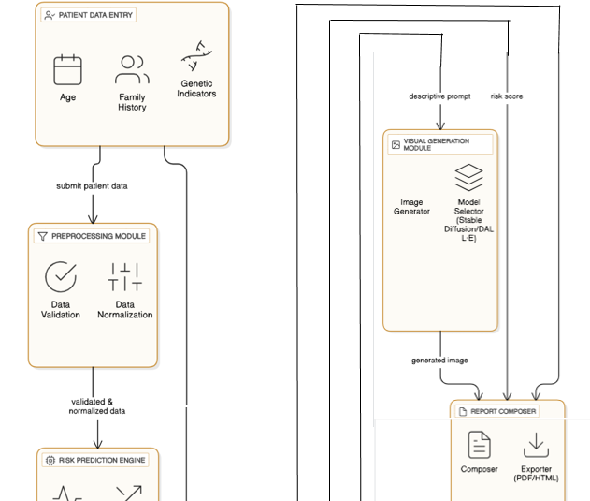
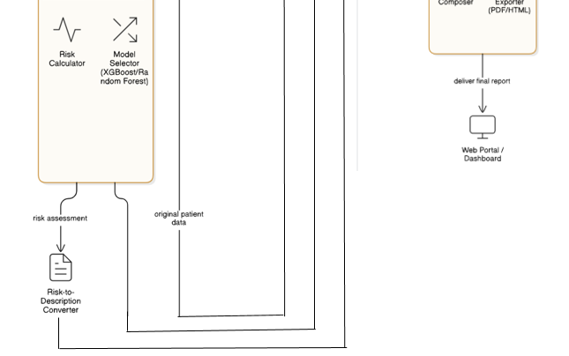
System Architecture
08

Slide 9
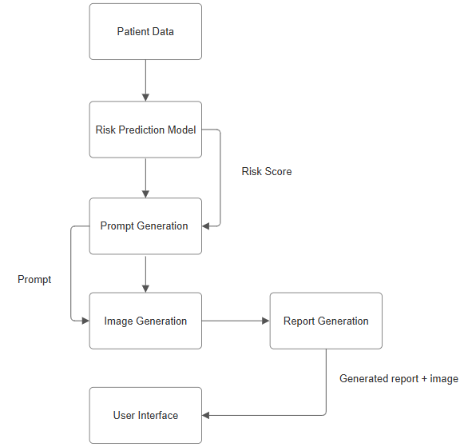
System Work-Flow
09

Slide 10
Result Analysis
Model Comparison: Baseline vs. Proposed System
Metric | Keras (Baseline DL) | TensorFlow (General DL) | River (Streaming ML) | XGBoost (Proposed) | Improvement
Accuracy | 75–80% | 78–82% | 70–75% | 85–90% | +8–15% higher
ROC–AUC | ~0.82 | ~0.85 | ~0.78 | >0.90 | Stronger separation
Training Speed | Slow (needs GPU) | Moderate (GPU/TPU support) | Fast (online updates) | Efficient on CPU/GPU | Faster, scalable
Interpretability | Low (black-box NN) | Low–Medium (with add-ons) | Medium (streaming, simpler) | High (feature importance) | More transparent
Suitability (Healthcare) | Good for imaging tasks | Good for imaging + deep models | Suited for continuous streams | Best for structured medical data | Most practical
Performance Highlights
Model Used: XGBoost (Extreme Gradient Boosting).
Dataset: 1,697 patient records (clinical, reproductive, and lifestyle factors).
Evaluation Metrics:
Accuracy: ~85–90% (robust classification for medical data).
ROC-AUC: >0.90, indicating strong ability to distinguish between positive and negative cases.
System Output:
Risk Score (e.g., 0.72 probability).
10

Slide 11
Advantages And Disadvantages
Advantages
Provides personalized risk prediction using structured clinical and lifestyle data.
Converts complex numerical scores into clear, descriptive text for better patient understanding.
Uses generative AI to create medical-style visuals, making results more intuitive and engaging.
Generates automated comprehensive reports (PDF/HTML) for patients and healthcare providers.
Offers a user-friendly web dashboard, ensuring accessibility across devices.
Disadvantages
Dependence on the quality and completeness of input data; noisy or missing values can affect predictions.
Generative AI visuals are symbolic, not diagnostic, and may be misinterpreted if not explained properly.
Requires computational resources for both risk prediction and image generation.
Adoption may be limited in low-resource healthcare settings with restricted digital access.
11

Slide 12
Conclusion
Risk2Image effectively bridges the gap between accurate prediction and patient understanding by combining machine learning–based risk forecasting with descriptive text and personalized generative visuals.
01.
The system enhances preventive healthcare and doctor–patient communication through automated reports and an accessible web dashboard, promoting early screening and timely interventions.
02.
12

Slide 13
References
Smith, J., & Lee, A. (2018). Predicting Breast Cancer using Machine Learning: A comparative study of SVM, Random Forest, and KNN. International Journal of Medical Informatics.
Zhang, Y., Kumar, R., & Chen, L. (2019). Deep Learning for Breast Cancer Diagnosis using Convolutional Neural Networks. IEEE Transactions on Medical Imaging.
Selvaraju, R. R., Cogswell, M., & Das, A. (2020). Explainable AI for Medical Imaging: Grad-CAM based interpretability in CNNs. Nature Biomedical Engineering.
Gupta, P., & Williams, D. (2021). Multimodal Breast Cancer Prediction: Integrating structured and imaging data. Journal of Biomedical Informatics.
13

Slide 14
Hernández, J., & Torres, M. (2019). Breast Cancer Risk Estimation with Machine Learning: Application of XGBoost to genetic datasets. Bioinformatics Advances.
Goodfellow, I., Pouget-Abadie, J., & Mirza, M. (2017). Generative Adversarial Networks in Healthcare: Synthetic medical image generation. Neural Information Processing Systems (NeurIPS).
Patel, S., & Kaur, N. (2020). Data-Driven Risk Visualization for Cancer: Infographic-based approaches. Health Informatics Journal.
Brown, T., & Johnson, E. (2021). AI-Driven Breast Cancer Risk Classification using Ensemble Methods and SHAP. Computers in Biology and Medicine.
14

Slide 15

THANK
YOU

